Slide 1
Media Arts Intro Series
Mr. Sultan –

Slide 2
What you will learn
Principles of Design in Media Arts
2 (out of 7) Elements of Design
2 (out of 9) Principles of Design

Slide 3
What are they?
Media Arts brings something different that a lot of other arts can’t achieve (because of the form it’s in, or because of the technology Media Arts can utilize)
Elements – THE Tools: Means essential (must) parts, small but significant (obvious & important) parts of your art piece.
Principles –HOW TO USE TOOLS: are the important way the tools can be used across the field (in all aspects of art), doesn’t matter what format it’s in (on TV, in advertising, on business cards/ t-shirts)

Slide 4
Duration – Media Arts
Time and how it can be manipulated (changed around to trick/ convince/ think) or presented in Art work. Can also explain the temporal (for a period of time) nature of art works that exist for a period of time.
Principles of Design for

Slide 5
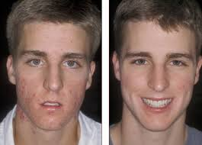
Duration
Before and After Pictures – Advertisement for Proactiv Solution Acne Cream
Noah Kalina – Time Lapse Effect
Taken from the pamperedpore.blogspot.com

Slide 6
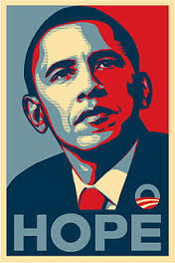
Duration
During the 2008 election
2 major wars
Economic Despair of America
8 years under President George W. Bush (who was remembered as someone not very good or inspiring)
Peaked the interest of a lot of young people
This poster/ media creation was never utilized again in the same way after the winning of the 2008 election.
Time and how it can be manipulated (changed around to trick/ convince/ think) or presented in Art work. Can also explain the temporal (for a period of time) nature of art works that exist for a period of time.

Slide 7
Elements of Design
Line
Horizontal, curved, vertical, concentric, thick, thin, broken, squiggly……
Can be used in Illustrator (vectors).
The Tools

Slide 8
Shape
Geometric shapes, TWO dimensional, flat, organically created (make up your own)
Again, great to create in Illustrator
The Tools
Elements of Design

Slide 9
Principles of Design
PATTERN
A regular arrangement of altered or repeated elements.
It could be repeated SHAPES, lines, colours, or motifs (a decorative image or design)
The HOW

Slide 10
Principles of Design
CONTRAST
The juxtaposition (idea on top of idea) of different elements of deign (rough & smooth, dark & light), but because of it, you see either:
Their differences
Create something cool to look at
Make a FOCUS point
The HOW

Slide 11
Up to now….
Principles of Design
Principles of Design for
MEDIA ARTS
DURATION
Hybridization
Interactivity
Point of View
Elements of Design
LINE
SHAPE
Form
Colour
Value
Texture
Space
PATTERN
CONSTRAST
Emphasis
Balance
Scale
Harmony
Rhythm/ Movement
Unity
Variety

