Slide 1
Media Arts Intro Series
Mr. Sultan –

Slide 2
What you will learn
Principles of Design in Media Arts
4 (out of 7) Elements of Design
4 (out of 9) Principles of Design

Slide 3
Up to now….
Principles of Design
Principles of Design for
MEDIA ARTS
DURATION
HYBRIDIZATION
Interactivity
Point of View
Elements of Design
LINE
SHAPE
FORM
COLOUR
Value
Texture
Space
PATTERN
CONSTRAST
EMPHASIS
BALANCE
Scale
Harmony
Rhythm/ Movement
Unity
Variety

Slide 4
What are they?
ELEMENTS = TOOLS
PRINCIPLES = HOW TO USE THOSE TOOLS

Slide 5
Hybridization– Media Arts
Is the technique used in creating art works in which genres, styles, concepts, materials, media, and forms are combined to create new “hybrid” forms.
combine
MIX
BLEND
Principles of Design for

Slide 6
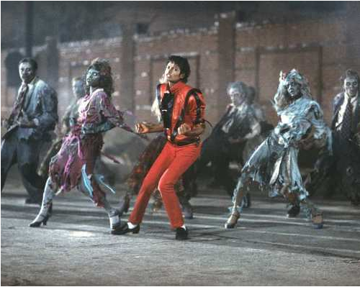
Hybridization
Michael Jackson - Music Videos
Mix of ideas:
Dance
Horror (song featuring Vincent Price)
Love Story
Zombie Classic (“Night of the Living Dead”)
Picture taken from latimesblog.com

Slide 7
Michael Jackson – “Leave Me Alone”
Mix of message from song about a girl, and the video about the media (newspapers, news, tabloids)
Mix media, animal-life, circus folk, theme parks
Stop motion animation with video, and 35mm recording.

Slide 8
Elements of Design
Form
3D – Three dimensional (pops out at you)
Geometric shapes (cone, sphere, cube) ← Again, 2D turned 3D
Organic shapes
The Tools

Slide 9
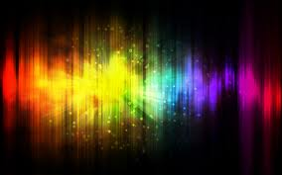
Colour
Wavelengths of light!Refers to:
Hue (name)
Value (lightness/ darkness)
Intensity (saturation, how “thick” the colour is)
Temperature (Warm or Cool)
Tint, Tone, Shade
The Tools
Elements of Design

Slide 10
Principles of Design
Emphasis
Special attention/ importance given to ONE part/ section of art work
Emphasis can be achieved through:
PLACEMENT (where you put it)
CONTRAST (we talked about last class – this would be a 2 in 1!)
COLOUR (just spoke about)
SIZE
REPEATITION (Think pattern!)
The HOW

Slide 11
Principles of Design
BALANCE
A feeling that “everything fits”
Everything is arranged symmetrically (in-line or equal) or asymmetrically (purposely unequal) to create this sense of EQUALITY in weight or importance.
The HOW

Slide 12
Up to now….
Principles of Design
Principles of Design for
MEDIA ARTS
DURATION
HYBRIDIZATION
Interactivity
Point of View
Elements of Design
LINE
SHAPE
FORM
COLOUR
Value
Texture
Space
PATTERN
CONSTRAST
EMPHASIS
BALANCE
Scale
Harmony
Rhythm/ Movement
Unity
Variety

